Slide 1

Telco Customer Churn Analysis
Insights, Strategies, and Predictive Modeling
Author: Ramesh Talapaneni

Slide 2

Agenda
Introduction and Business Problem: Overview of customer churn and its impact on telecom companies.
Dataset and Methodology: Summary of the dataset, preprocessing steps, and modeling approach.
Exploratory Insights: Key trends and visualizations discovered during the analysis.
Retention Strategies: Actionable recommendations to reduce churn and improve retention.
Conclusion and Future Directions: Summary of findings, ethical considerations, and next steps.

Slide 3

Introduction and Business Problem
Customer churn is a critical issue for telecom companies, leading to revenue losses and higher customer acquisition costs.
Retaining existing customers is more cost-effective than acquiring new ones, making churn reduction a strategic priority.
This presentation explores the factors driving churn and provides actionable insights to improve customer retention.

Slide 4
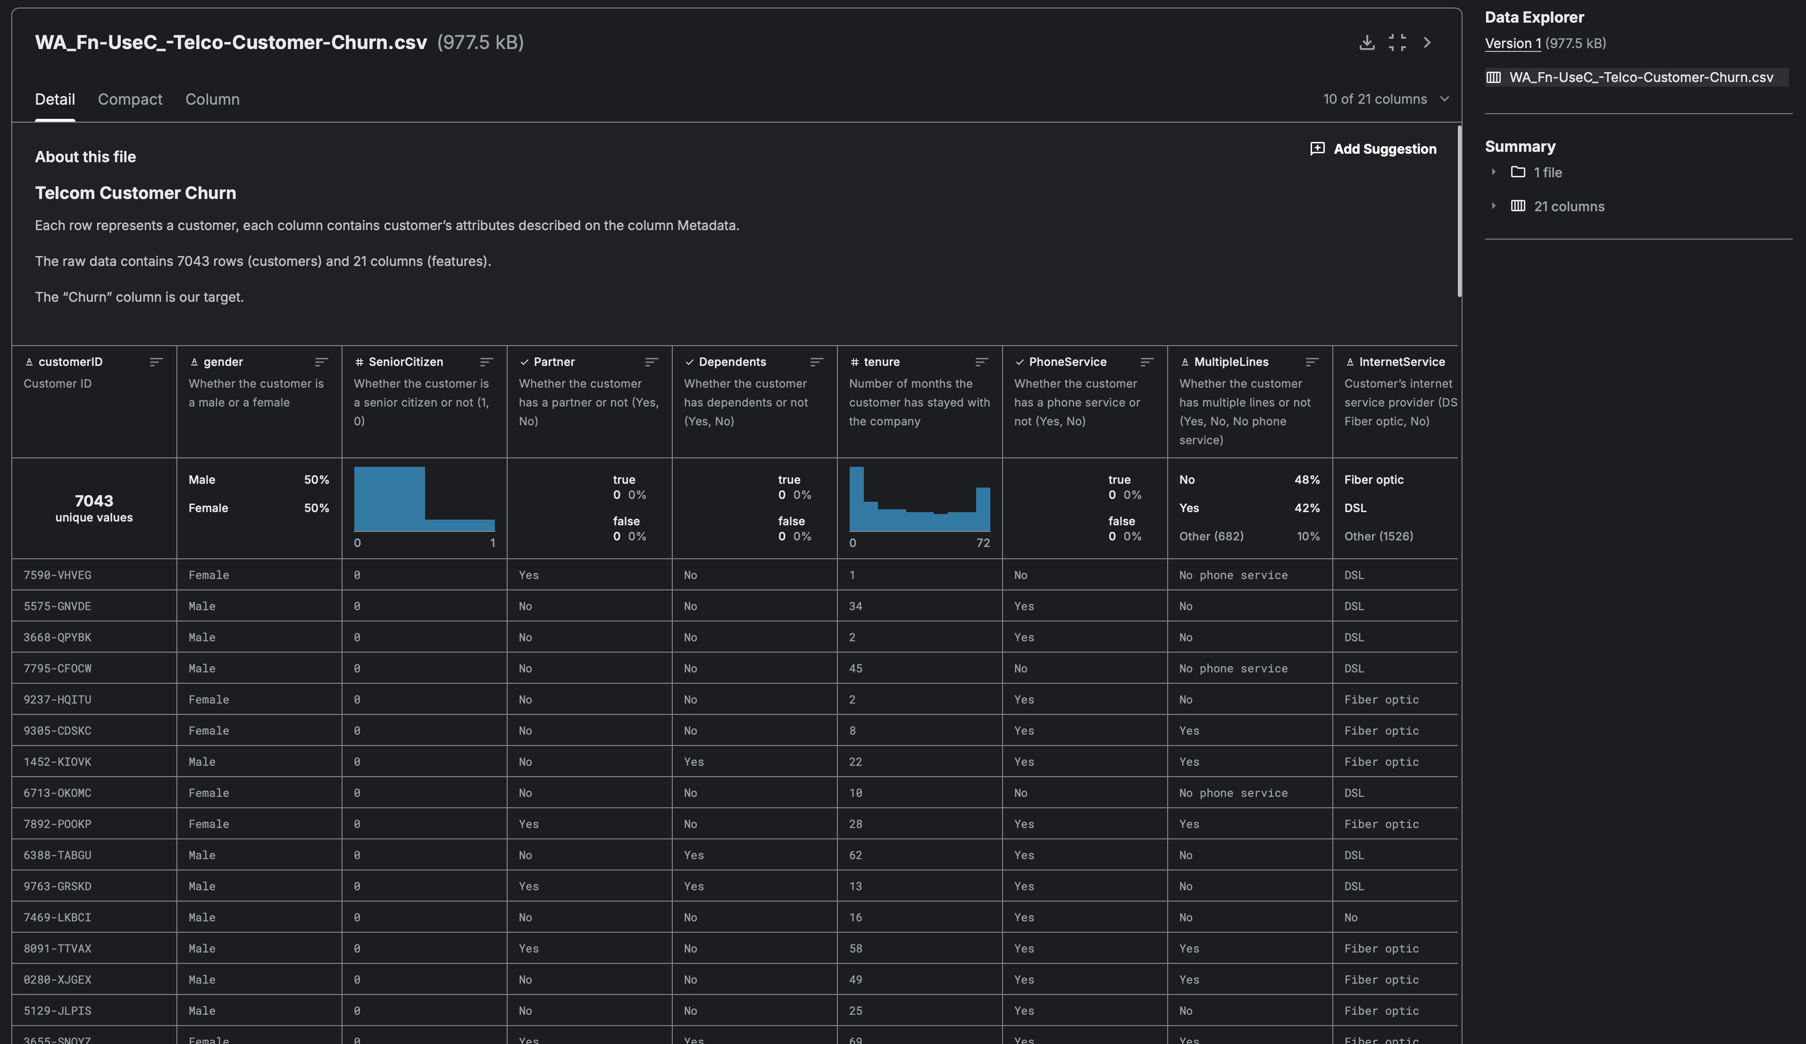
Dataset Overview
Source: Kaggle - Telco Customer Churn Dataset
7,043 records with 21 features, including:
Customer demographics (e.g., senior citizen, gender).
Service details (e.g., internet service type, contract type).
Billing information (e.g., monthly and total charges).
Target: Churn (Yes/No)

Slide 5
Methodology
Missing values in TotalCharges handled by median imputation.
Categorical variables (e.g., Contract, PaymentMethod) one-hot encoded.
Numerical features (e.g., MonthlyCharges, TotalCharges) scaled.
Dataset split: 80% training, 20% testing.
SMOTE applied to address class imbalance.

Slide 6
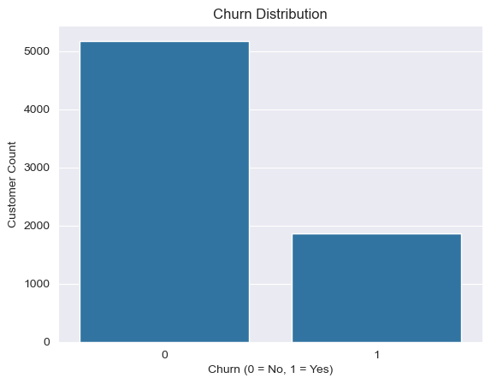
Data Analysis – Churn Distribution
Approximately 26% of customers in the dataset have churned.
Highlights a significant imbalance between churned and non-churned customers.
The churned customer segment, though smaller, has a disproportionately high impact on revenue loss and customer acquisition costs.
Understanding churn distribution helps prioritize strategies aimed at retaining at-risk customers.

Slide 7
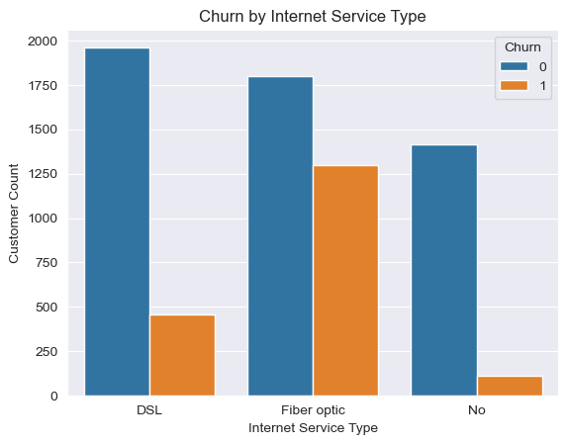
Data Analysis – Internet Service Type
Fiber-optic internet users exhibit significantly higher churn rates compared to DSL or no internet services.
DSL users show lower churn rates, indicating relatively higher satisfaction or fewer competitive alternatives in this segment.
Customers with no internet service have the lowest churn rates, possibly due to fewer service dependencies or simpler billing structures.

Slide 8
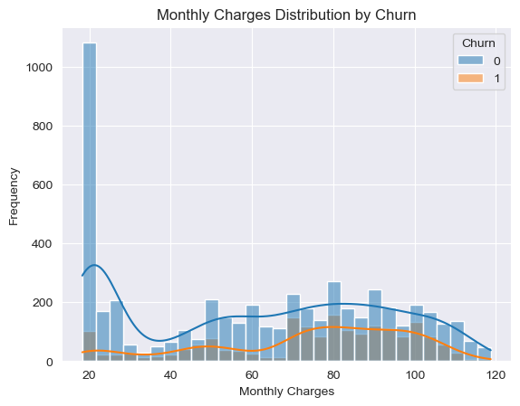
Data Analysis – Monthly Charges
Higher monthly charges are strongly correlated with increased churn rates.
Customers on premium plans may feel dissatisfied with the value for money offered.
Price-sensitive customers are more likely to leave when faced with rising costs or competitive alternatives.
Low-cost plans appear to provide more stability, retaining customers over a longer period.
Customers with low charges may perceive better affordability and alignment with their needs.

Slide 9
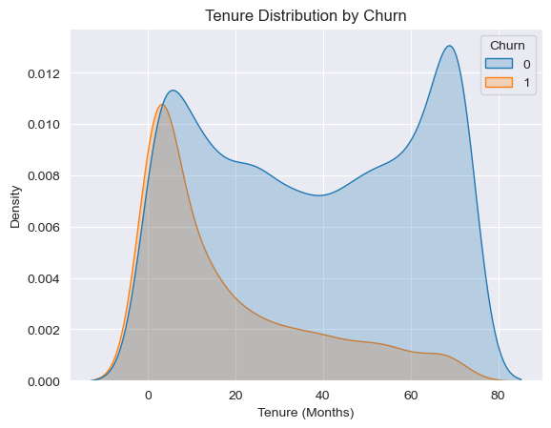
Data Analysis – Tenure Insights
Short-tenure customers (those with fewer months of service) have a significantly higher likelihood of churning.
New customers may feel uncertain about the value or quality of the service during the initial months.
Early churn suggests possible gaps in onboarding, support, or initial expectations not being met.
Long-tenure customers are more likely to stay, indicating loyalty builds over time with positive experiences.

Slide 10
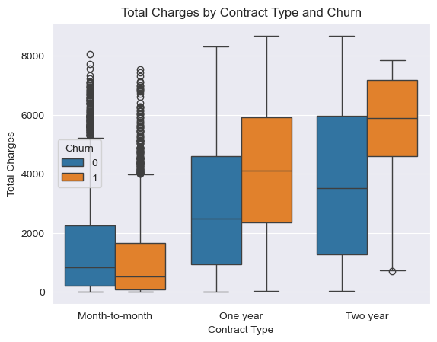
Data Analysis – Total Charges Insights
Long-term contracts (1-year, 2-year) are associated with higher total charges but significantly lower churn rates, indicating customer loyalty.
Month-to-month contracts have higher churn rates due to their flexibility, making it easier for customers to leave.
Promoting long-term contracts with incentives or discounts could help reduce churn while maintaining revenue stability.

Slide 11
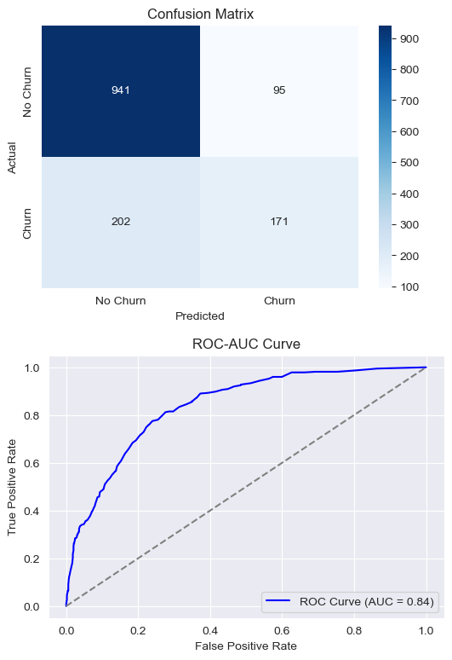
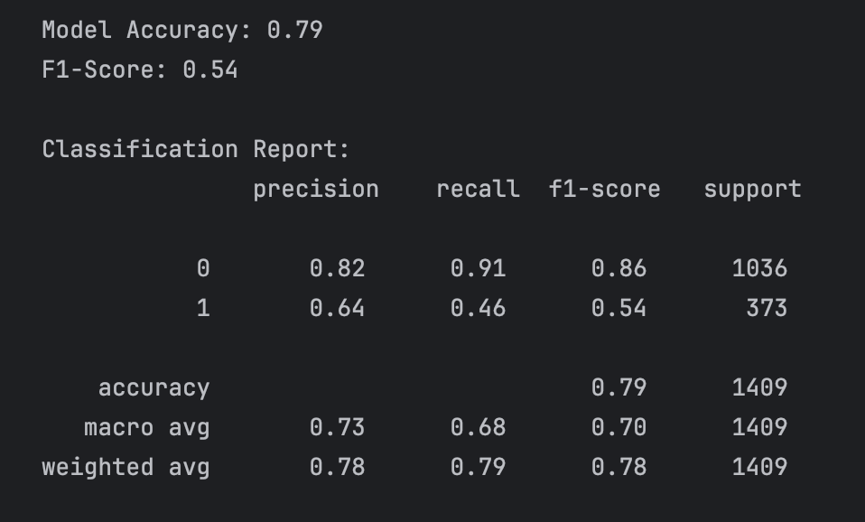
Predictive Modeling
The Random Forest model achieved an accuracy of 79%, an F1-score of 0.54, and an ROC-AUC of 0.84, showing moderate performance in churn prediction.
Precision (0.82 for non-churn, 0.64 for churn) and recall (0.91 for non-churn, 0.46 for churn) highlight the model's strength in predicting non-churn but limitations for churned customers.
Enhancing the model through techniques like addressing class imbalance can improve its effectiveness in driving retention strategies and reducing churn.

Slide 12

Retention Strategies
Provide attractive discounts and incentives to encourage customers to opt for long-term contracts, fostering loyalty.
Enhance service quality and tailored support for senior citizens, a demographic that may require additional attention.
Introduce flexible pricing plans to address cost-related concerns and retain price-sensitive customers.
Implement proactive monitoring systems to identify customer issues early and resolve complaints swiftly to improve satisfaction.

Slide 13

Challenges and Ethical Considerations
Manage class imbalance effectively by applying techniques like SMOTE to improve model accuracy for underrepresented churn cases.
Ensure fairness in predictions by mitigating potential biases in the data and algorithms.
Safeguard customer privacy through robust data security measures and compliance with regulations.
Promote transparency in model outcomes to build trust and support ethical decision-making.

Slide 14

Conclusion
Tenure, contract type, and monthly charges are the most influential predictors of customer churn.
Implementing targeted strategies based on these predictors can effectively reduce churn rates and enhance retention.
The model's strong performance offers actionable insights to drive data-informed decision-making.
Leveraging these insights enables businesses to focus on high-impact areas for improving customer satisfaction and loyalty.

Slide 15

Future Directions
Implement real-time churn prediction systems to proactively identify at-risk customers and take timely action.
Integrate predictive analytics with CRM platforms to enable personalized customer engagement and targeted retention efforts.
Enhance the dataset by incorporating additional behavioral attributes to improve model accuracy and insight depth.
Use advanced analytics to continuously refine retention strategies and address emerging customer needs.

Slide 16

Thank You

